Slide 1
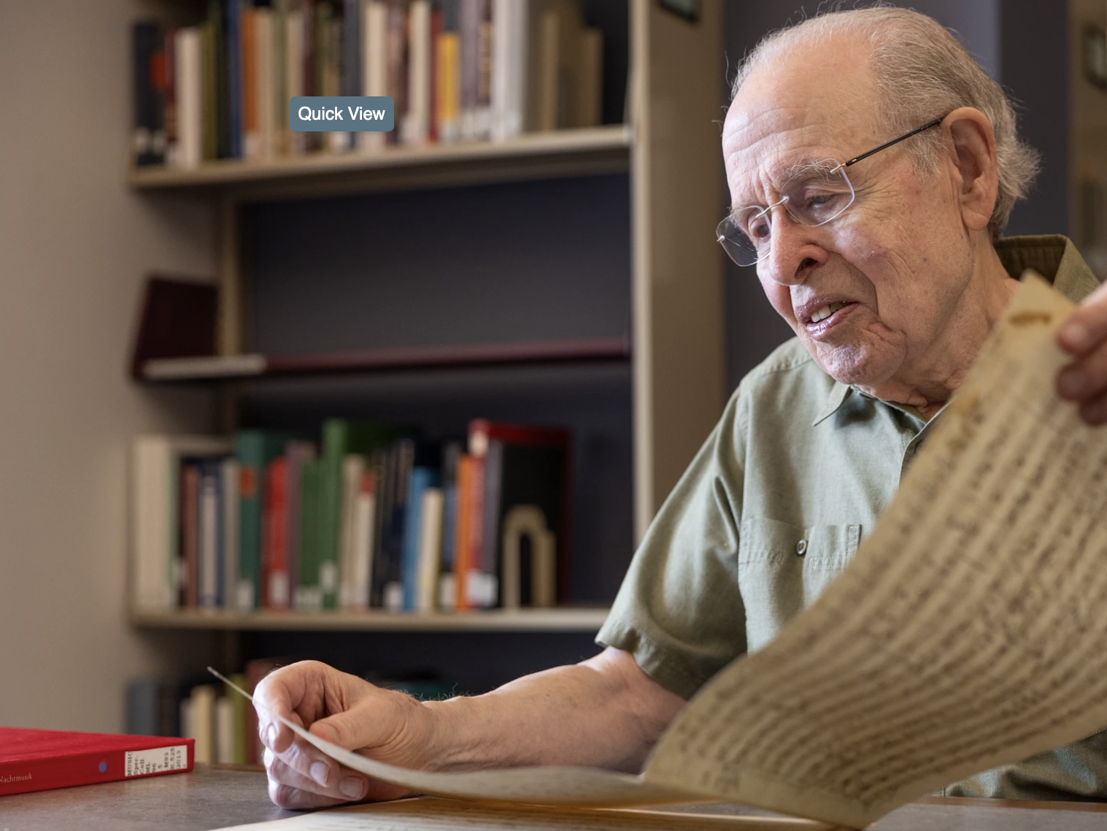
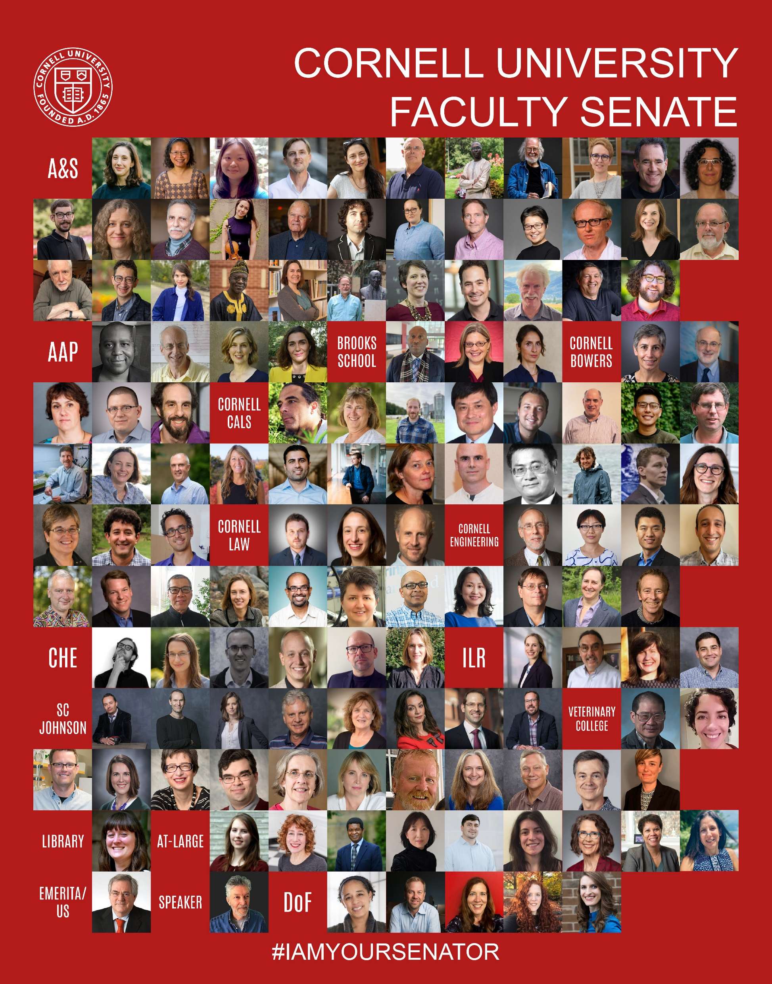
Office of the Dean of Faculty

Slide 2
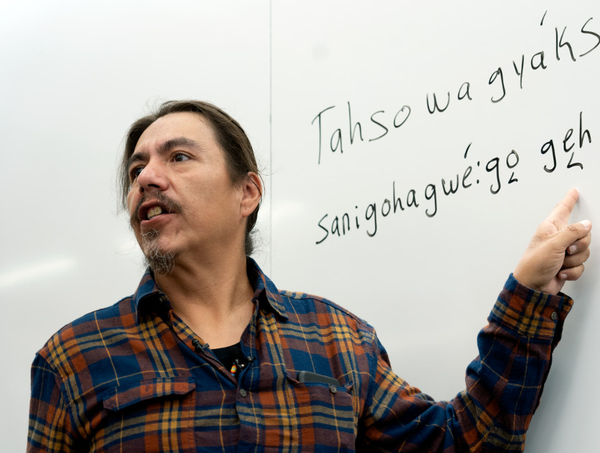
Gayogo̱hó꞉nǫʼ Land Acknowledgement
Cornell University is located on the traditional homelands of the Gayogo̱hó꞉nǫ' (the Cayuga Nation). The Gayogo̱hó꞉nǫ' are members of the Haudenosaunee Confederacy, an alliance of six sovereign Nations with a historic and contemporary presence on this land. The Confederacy precedes the establishment of Cornell University, New York state, and the United States of America. We acknowledge the painful history of Gayogo̱hó꞉nǫ' dispossession and honor the ongoing connection of Gayogo̱hó꞉nǫ' people, past and present, to these lands and waters.
This land acknowledgment has been reviewed and approved by the traditional Gayogo̱hó꞉nǫ' leadership.

Slide 3
Welcome & Welcome Back Senators!
Faculty Senate Orientation
August 27, 2025
Who we are
Introductions
  Dean of Faculty
  Associate Dean of Faculty
  Speaker
  University Faculty Committee
  Senate Committee Chairs
Faculty Senate Functions and Procedures
Discussion & Questions

Slide 4
Who we are
University Faculty: 1,600 + Research-Teaching-Extension Faculty: 800
Emeritae/i Faculty: 775
Campuses: 3 (Ithaca, Geneva, and Cornell Tech)
Colleges and Schools: 13
Departments: 88
Senators: 135
Senate Committees: 12 + 2 working groups

Slide 5
Democratically Elected
Elected by Entire faculty
Dean of Faculty
Associate Dean of Faculty
University Faculty Committee
  Sets the Senate meeting agendas. Meets with the President, the Provost, and the Executive Committee of the Board of Trustees
Nominations and Elections Committee
  Oversees the staffing of Senate committees and faculty elections.
  Assists with the faculty staffing of Provost-based committees
University At-Large Senators
Faculty Trustees
Voting Members Elected by Departments or College RTE At-Large
Senators
Emeritae / Emeriti
Cornell University Library
Elected by the Senate
Speaker

Slide 6

Office of the Dean of Faculty
Dean of Faculty
Eve De Rosa
(Elected)
Associate Dean of Faculty
Adam T. Smith
(Elected)
Executive Staff
Assistant
Jill Short
Staff Assistant
C.A. Shugarts
CAPE Staff
Assistant
Melissa Rooklidge
University Faculty Committee
Liaison and sets the agenda for Senate meetings
9 Members (Elected)
Nominations and Elections Committee
Staffs the Senate committees and faculty elections
9 Members (6 Elected)
Faculty Senate
130 Senators
12 Senate Committees
AD WHITE AFPSF CAPP EPC FACAPE FACTA FCPR FPC LIBRARY MUSIC ROTC LECTURES
Faculty Volunteer Engine

Slide 7
Faculty Senate Committee Chairs
A.D. White-Professors-At-Large - Bob Weiss
Academic Freedom and Professional Status of Faculty - Tracy Stokol
Committee on Academic Programs and Policies – Tom Pepinsky
Educational Policy Committee – Jillian Goldfarb
Faculty Advisory Committee on Tenure Appointments – Eve De Rosa
Faculty Advisory Committee on Athletics & Physical Education - Ashleigh Newman
Financial Policies Committee – Luis M. Schang
University Lectures Committee - Phil Nicholson
University Library Board - Karim-Aly Kassam
University-ROTC Relationships Committee – Bill Philpot
Committee on Music - Roger Stephen Gilbert
RTE Working Group – Kim Kopko and John Callister

Slide 8
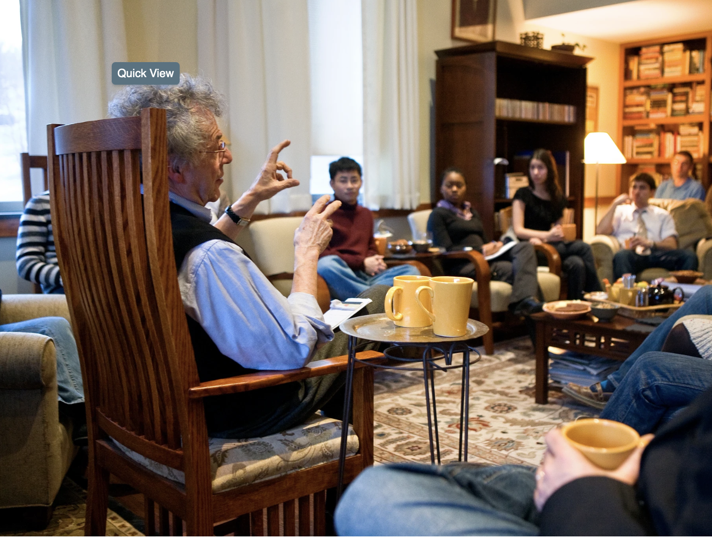
New Legislation
FACULTY:
  Visibility of the department chair’s letter to the dean in
  tenure cases
  Selection process for external reviewers in tenure cases
  Teaching Professor academic title in Bowers Computing and Information Science
  Teaching Professor academic title in the Brooks School of Public Policy
  Teaching Professor academic title in Cornell Engineering

Slide 9
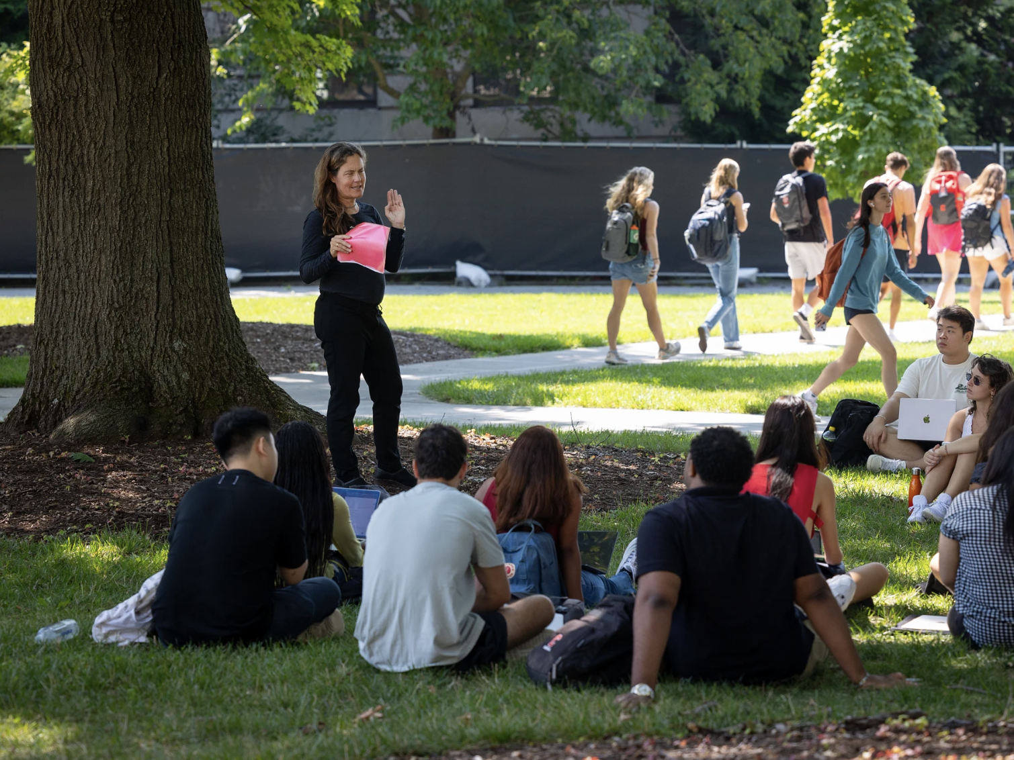
New Legislation
ACADEMIC:
  Adopt a unified transfer credit policy for undergraduate transfer students
OTHER
  Concerning increased police and security cameras on campus
  Concerning violations of faculty Academic Freedom

Slide 10
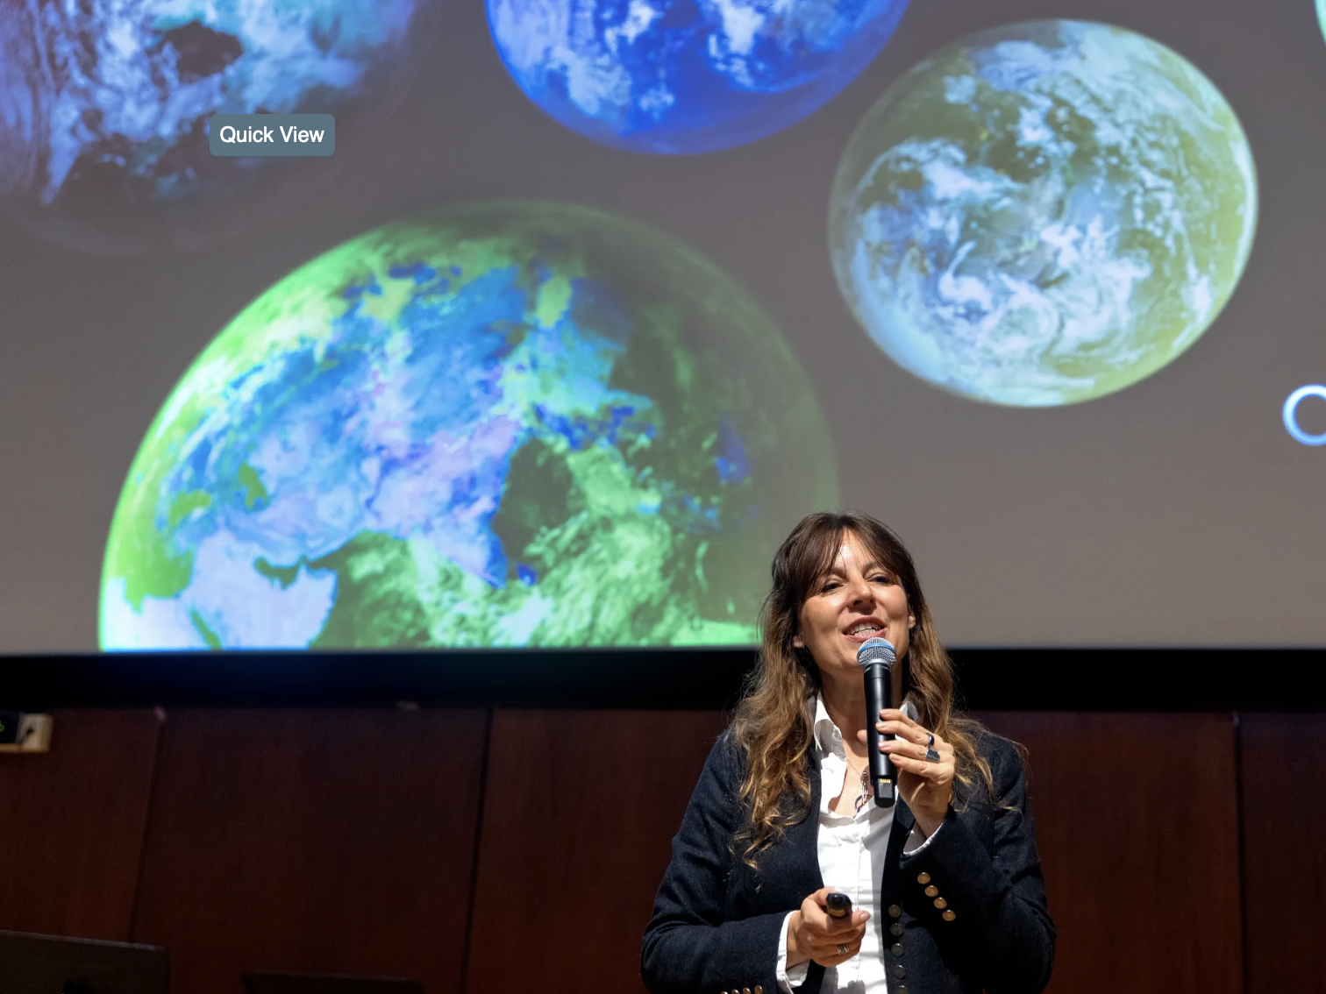
Additional Topics
Engaging viewpoint diversity in the classroom
Graduate student unionization
Established academic integrity working group
Student Code of Conduct – Use of academic and non-academic temporary suspensions
Cornell Committee on Expressive Activity report
Local Child Care Development
Shared Governance: Generative Artificial Intelligence Advisory Council
Guidance and resources available regarding executive orders
Research Integrity Council annual report
Local Economic Snapshot
Generative Artificial Intelligence Advisory Council

Slide 11
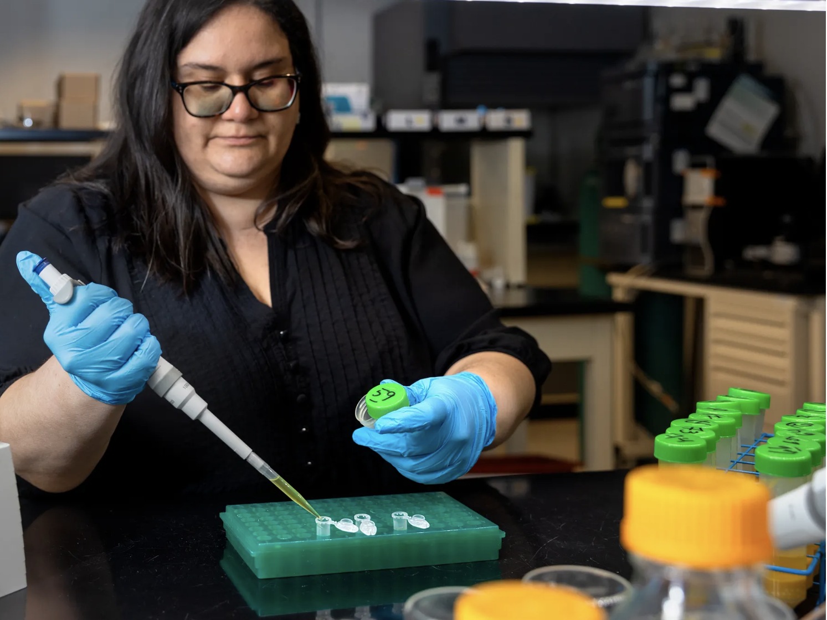
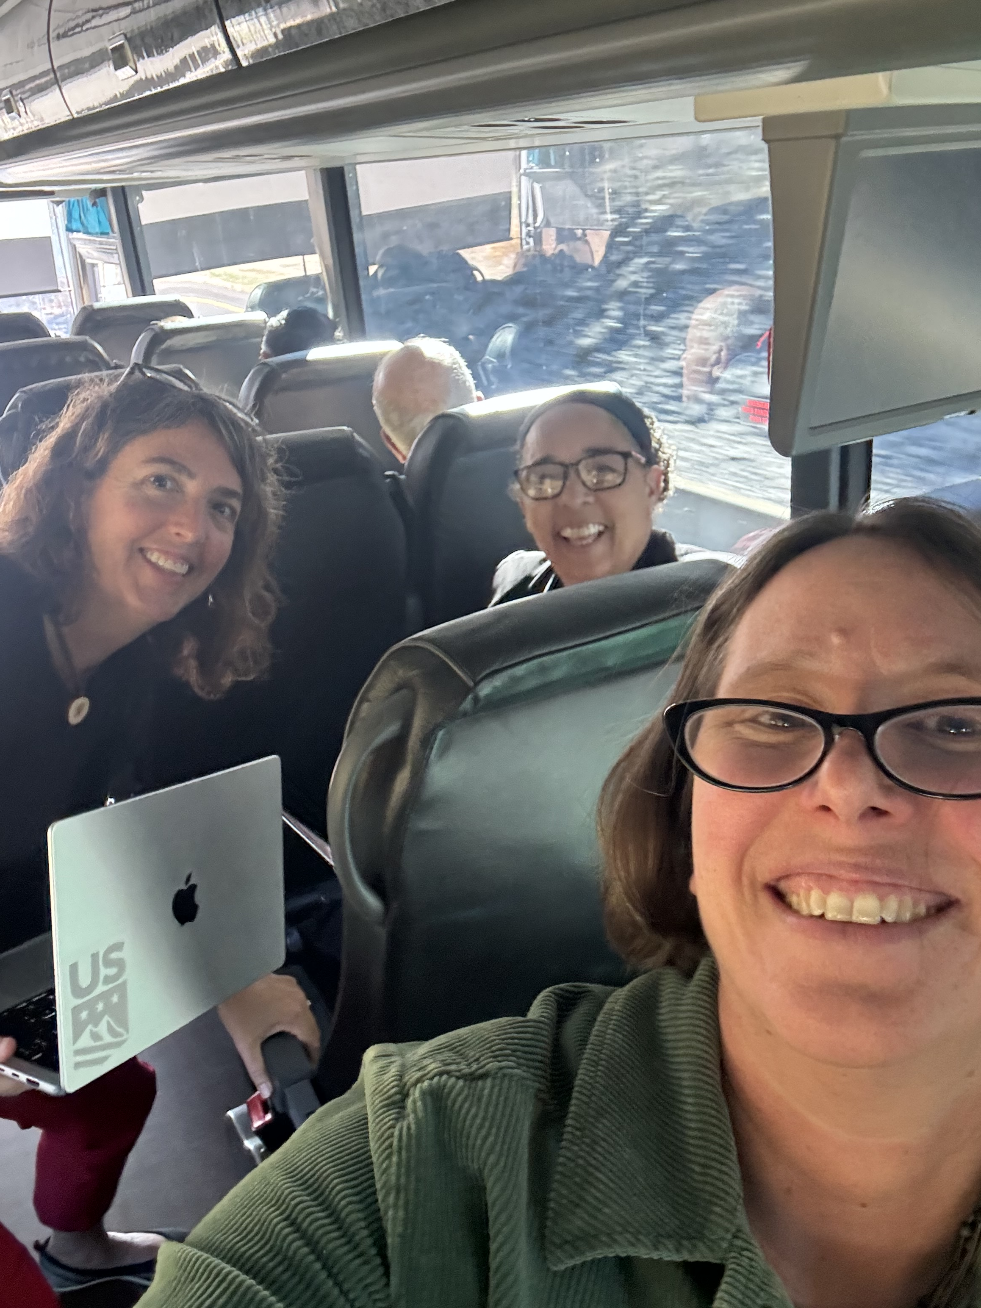
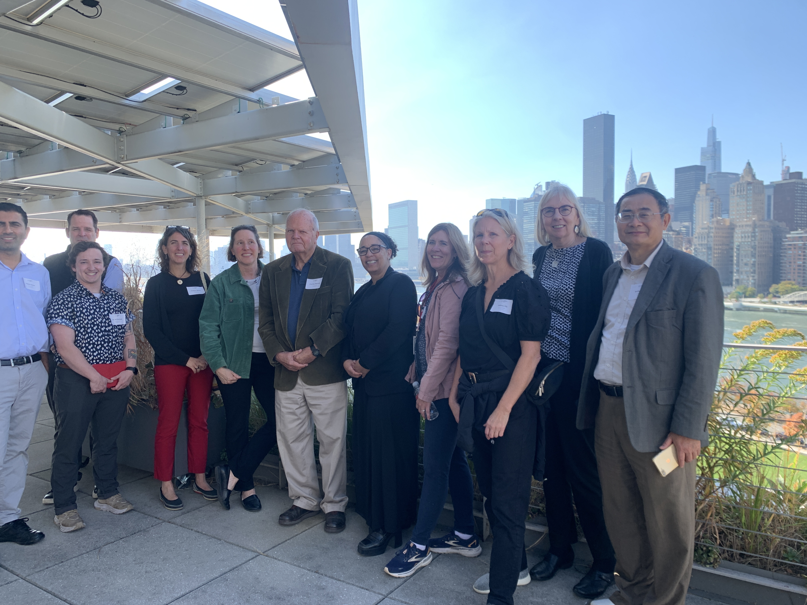
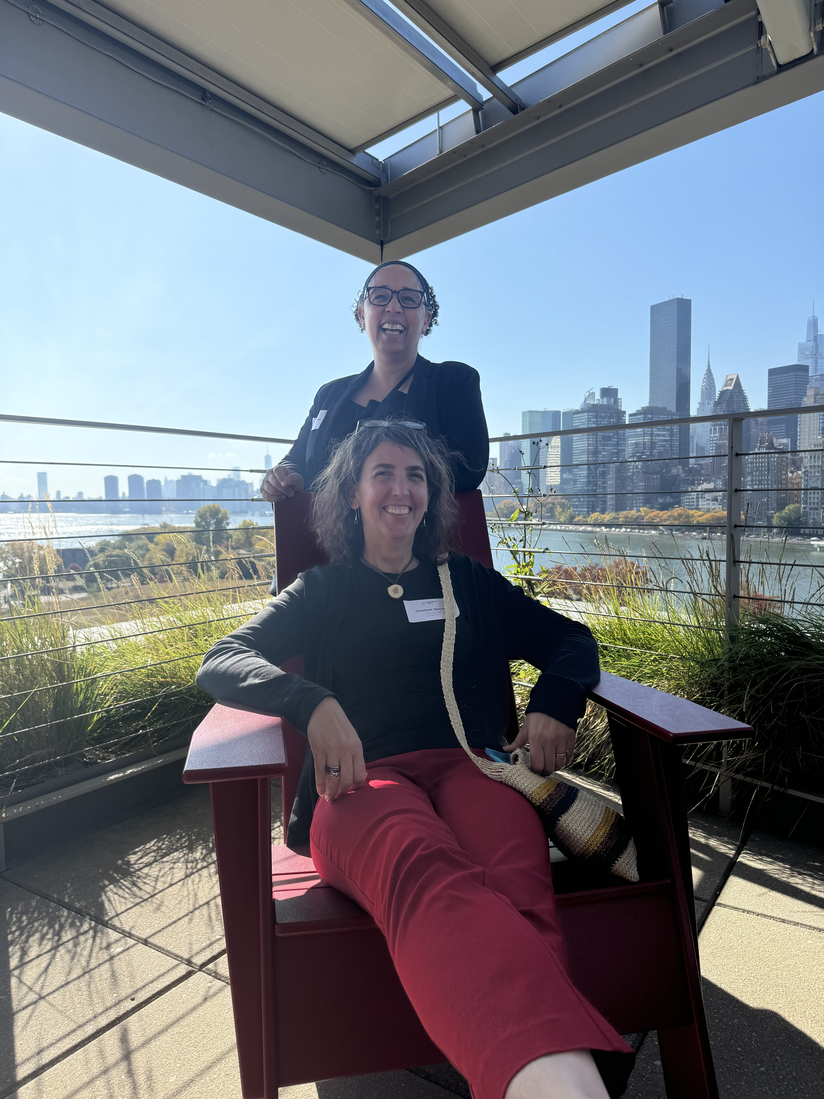
24-25 Cornell Tech Field Trip
Imagining the future of “any person…any study…”

Slide 12
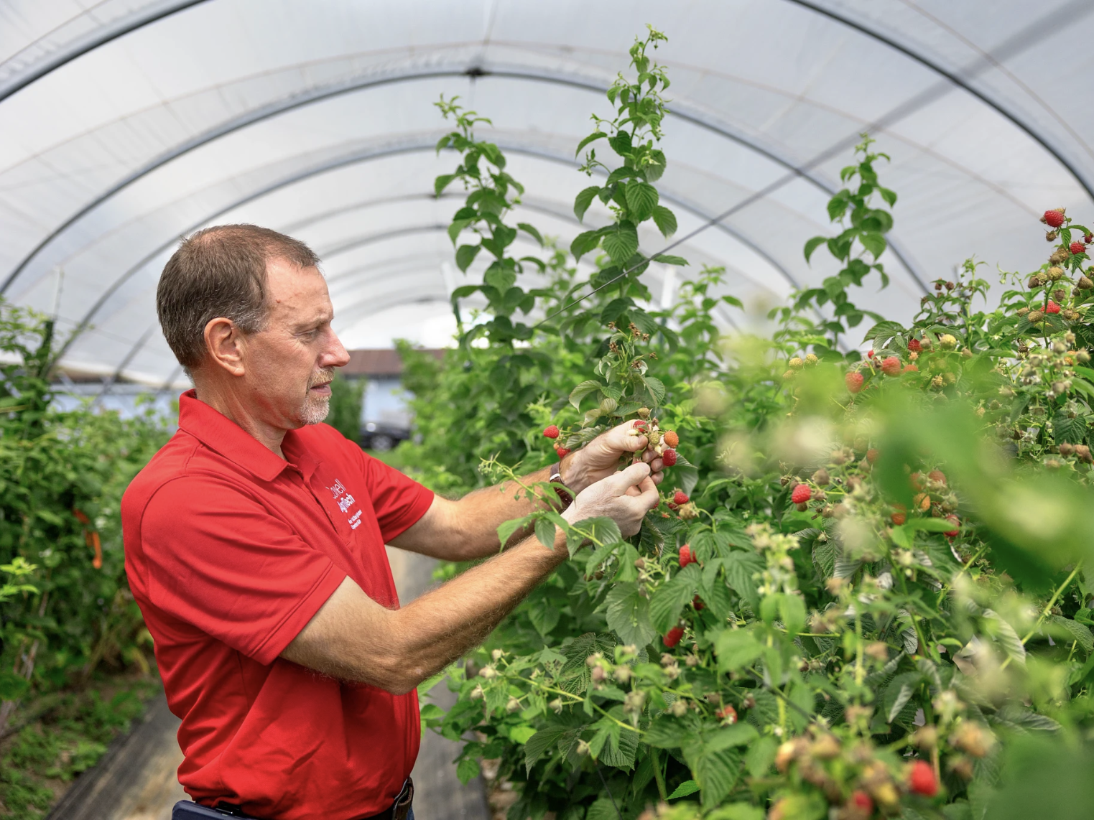
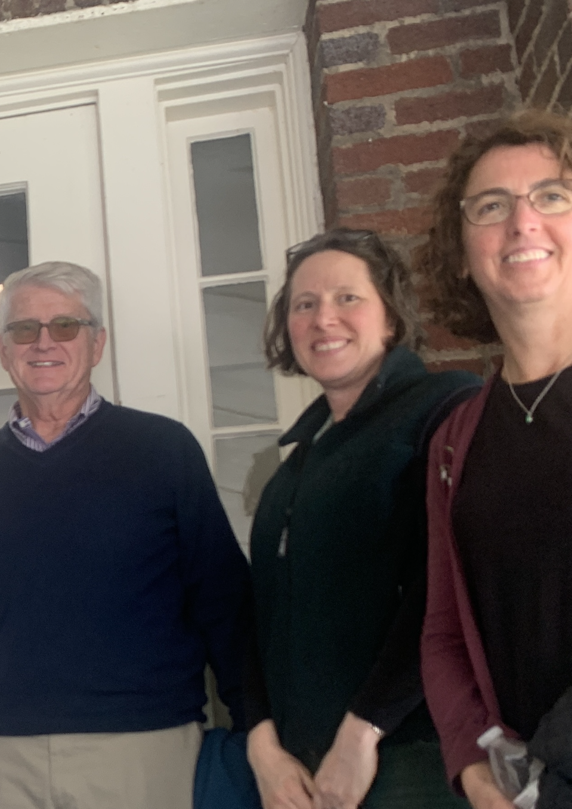
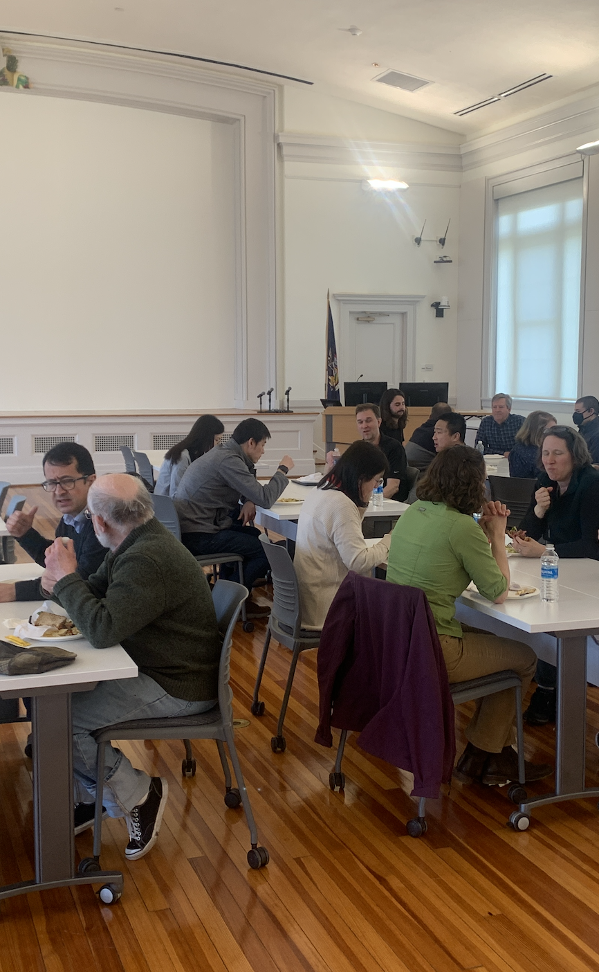
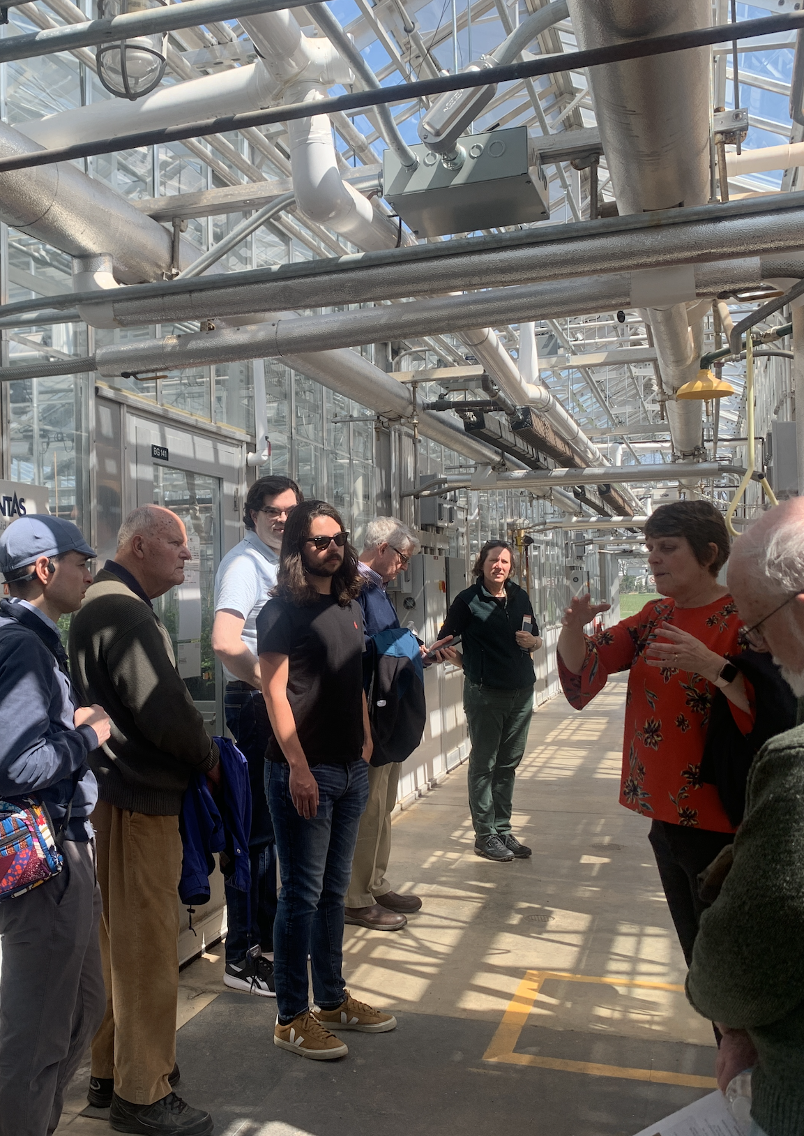
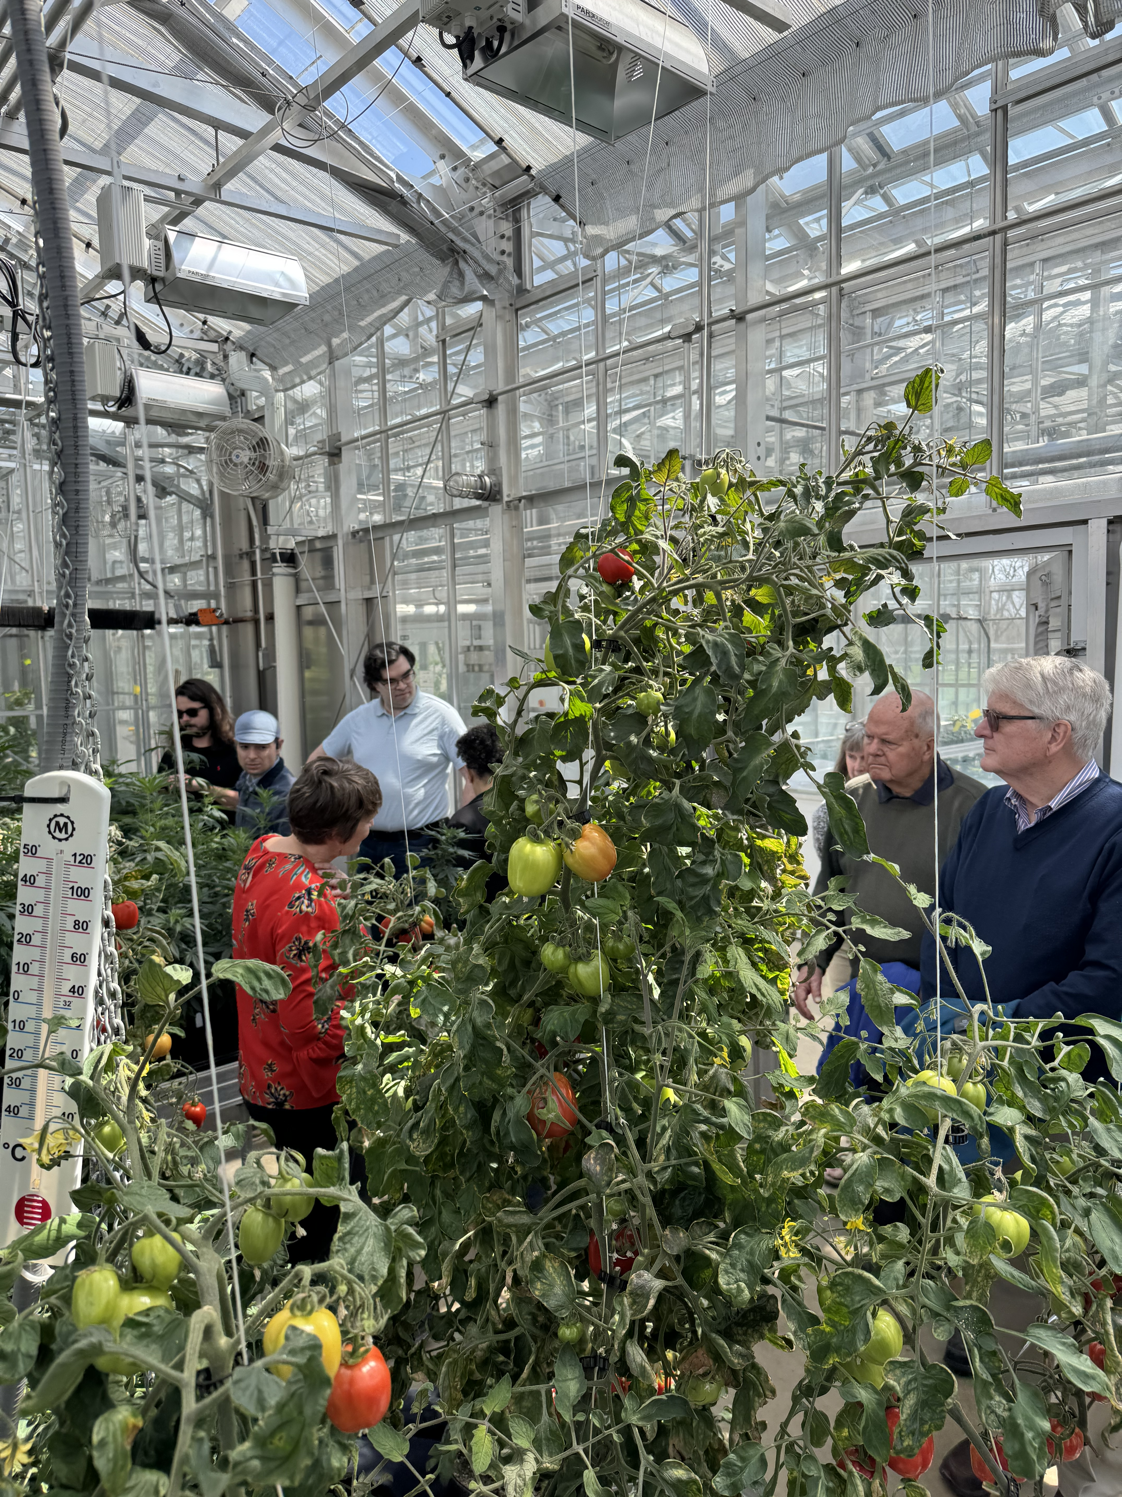
24-25 AgriTech Field Trip
How can faculty collaborate to support one another and contribute to Cornell?

Slide 13
Shared Governance
Over the years the Faculty Senate has recommended steps that should be taken to maintain a high level of shared governance.
Resolution 12. Principles of Cooperation and Consultation Between the President and Faculty Senate. (May 10, 2000)
Resolution 70 Report and Recommendations of the Faculty Senate Committee to review faculty governance. (March 14, 2007)
Resolution 87 Protocols to Ensure Faculty Governance (February 9, 2011)
Resolution 107 Shared Governance in Matters of Educational Policy as Required by Article 13. (April 8, 2015)
Undergraduates students, graduate students, and employees are very much part of the picture: Shared governance and the Assemblies

Slide 14
Prior to the Faculty Senate Meeting
Before each Senate meeting, the University Faculty Committee (UFC) meets to discuss and set the Senate meeting agenda.
The Friday before each Senate meeting the agenda is posted on the DoF website and emailed to the Senators.
    Comments relevant to the meeting can be posted on the agenda page.
Senators are requested to contact the Dean of Faculty about any motions that they intend to advance at the meeting.
  This is to insure efficient and maximum use of faculty time.
The agenda is also circulated to the entire faculty in the Monday Message.

Slide 15
During the Meeting
Any member of the faculty is welcome to attend a Senate meeting and speak. We request that each contribution is limited to 2 mins to allow for more voices.
Anyone outside of the faculty or guest of the faculty interested in attending a Faculty Senate meeting (either in person or via zoom) should register their attendance to the Office of the Dean of Faculty prior to the meeting.
Members are strongly encouraged to send all proposed amendments to the DoF office 24 hours prior to the meeting.
Because of quorum, attendance needs to be taken. Physical sign-up sheets are available at the in-person meeting and zoom attendees must indicate their attendance in the chat.
  Fifty percent attendance is required for quorum.

Slide 16
During the Meeting
There is a speaker who oversees the execution of the agenda. The current speaker is Jonathan Ochshorn.
  The Speaker may select one or more Parliamentarians to advise him or her on questions of parliamentary law and procedure arising in the course of Faculty Senate meetings.
  An effort is made to follow Roberts Rules. Here is a simplified version, Peter Stein’s version, and a more detailed version. Non-substantive (i.e., stylistic, grammatical, or clarifying) amendments may be freely introduced at a meeting without prior circulation.
  The speaker will rule substantive amendments out of order, but the speaker’s ruling can be reversed by majority vote of the body.

Slide 17
During the Meeting
Members may also move to postpone action to the next meeting if they believe a new approach deserves more timely consideration.
The order of business of every meeting will include a brief “Good of the Order” section at the end of the meeting, where remarks (but not motions) on any subject of interest to the faculty will be in order.
  Faculty members must inform the Speaker of their intention to address the Senate prior to the start of the meeting.
  In the absence of prospective speakers, the Speaker will re-allocate the reserved time to other agenda items.
At the discretion of the Dean of Faculty, a Senate roll call vote can be initiated at any time during a meeting.
For the legislation or action to take effect, ballots submitted electronically over a period of one week and the number of votes cast must be at or above the level of quorum.

Slide 18
After the Meeting
Fridays after the Senate meeting, a meeting synopsis is emailed the Senators to share with their department/unit faculty.
Senators and others who did not get a chance to speak can post their comments publicly on the meeting webpage.
After the Senate meeting, a tentative transcript is posted in the Senate Materials archive where it can be reviewed for accuracy.
Any resolution that passes a vote of the Senate, typically done via a Qualtrics survey after the meeting, becomes part of the resolution archive.
Pending matters and legislation are posted publicly.
After the tentative transcript/minutes are approved at a subsequent Senate meeting, the posted transcript becomes “final.”

Slide 19
Placing a Motion
To place a motion on the agenda of a Faculty Senate meeting, it must be endorsed in one of the following ways:
By a Faculty Committee
By the University Faculty Committee (UFC) (on its own initiative or in response to a request by a Faculty Senate member)
By any 4 Faculty Senators
By any 25 members of the Faculty
Upon the recommendation of the UFC, motions that are for consideration are posted on the pending matters webpage at least one week in advance of the meeting.
It is possible to propose a motion during a Faculty Senate meeting.
The vote on a particular resolution never takes place during the meeting at which the resolution is actually presented.

Slide 20
Meeting Dates
All meetings will be 3:30-5:00 p.m. on the second Wednesday of the month during the academic year (Meeting dates are subject to change.)
Hybrid Format
Zoom will be available; Faculty Senators will receive the zoom link to disseminate to faculty (or non-faculty guests with permission from the Office of the Dean of Faculty)
2025-26 Academic Year Dates in Schwartz Auditorium, Rockefeller Hall
  September 10, October 8, November 12, & December 10
  Reserved dates: September 17, October 22 & November 19
  February 11, March 11, April 8, & May 6
  Reserved dates: February 25, March 25 & April 22

Slide 21
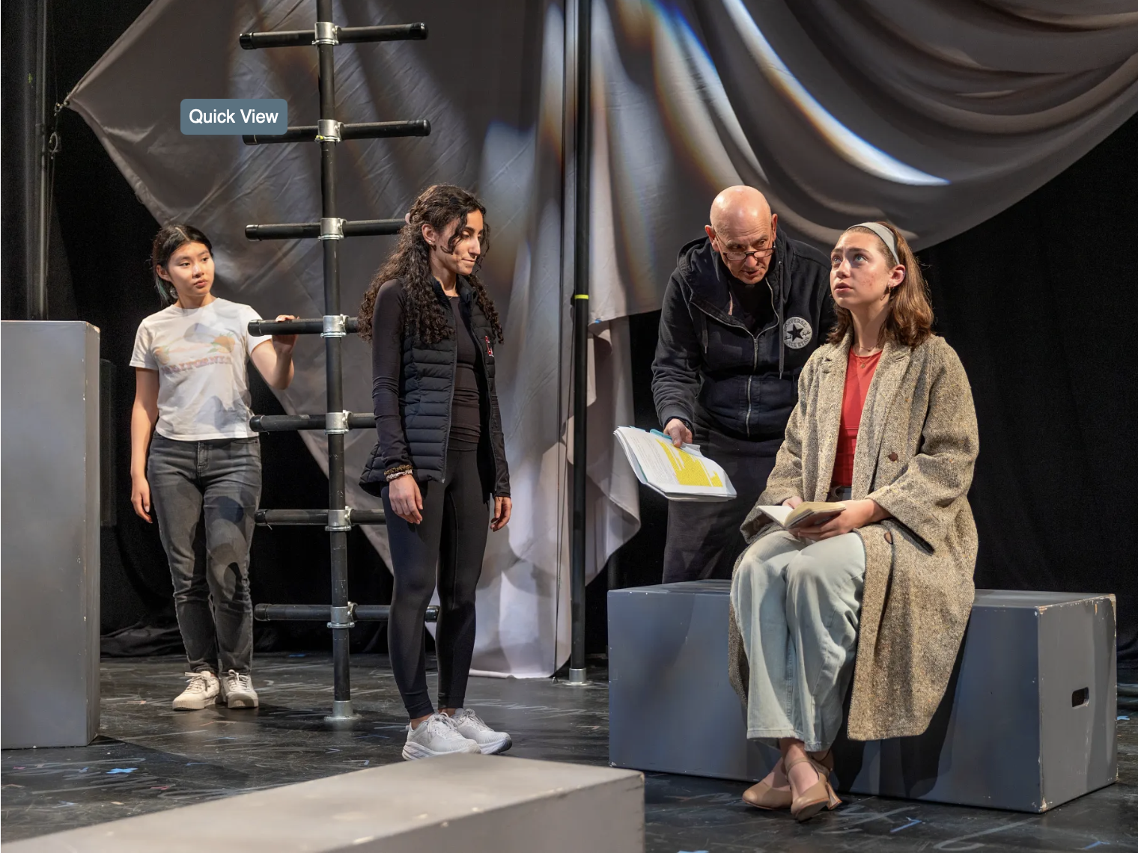
Discussion & Questions

